Slide 1
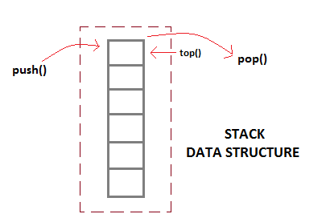
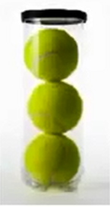
Stack
A stack is a linear data structure consisting a list of element in which elements can be inserted or deleted at one end which is called as TOP of the stack.

Slide 2
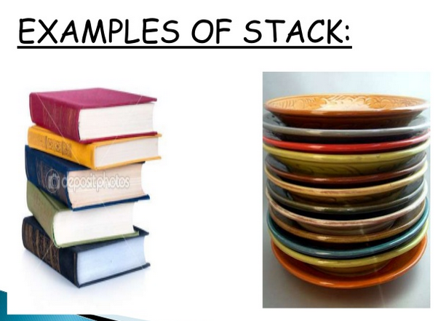

Slide 3
Define stack
A non-primitive linear data structure where insertion is done from one end called ‘top’ and deletion is done from the same end is known as stack.

Slide 4
Stack is a LIFO(Last in First out) structure
push() function is used to insert new elements into the Stack
pop() function is used to remove an element from the stack. Both insertion and removal are allowed at only one end of Stack called Top.

Slide 5
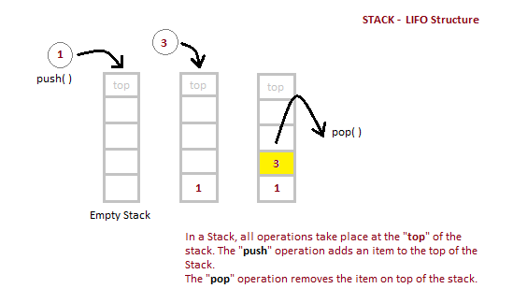

Slide 6
Stack is said to be in Overflow state when it is completely full and is said to be in Underflow state if it is completely empty.
The simplest application of a stack is to reverse a word. You push a given word to stack - letter by letter - and then pop letters from the stack.

Slide 7
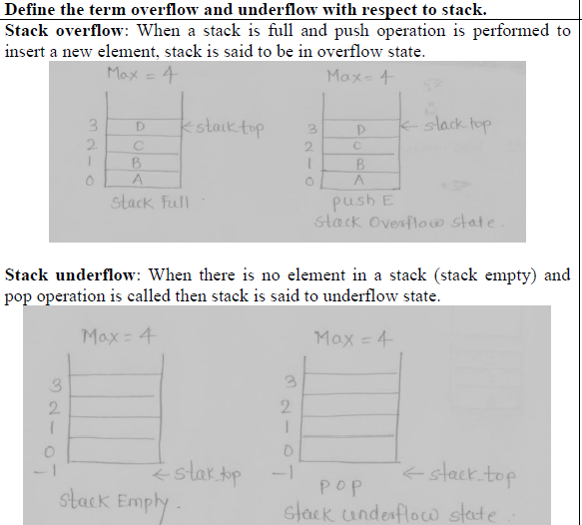

Slide 8
Applications of Stack
1.Recursion
2.Keeping track of function calls
3.Evaulation of expression

Slide 9
Stack as an ADT(abstract data type)
A stack of elements of any data type can be given as a finite sequence of elements of that type.
Adt = data elements + operations

Slide 10
Formally stack may be defined as follows:
typedef struct stack
{
int data [size];
int top;
}stack;
size is constant, maximum number of elements that can be stored

Slide 11
Stack as an ADT
C implementation of stack:
A stack , s of integer data type can be defined as:
int s[10];
int top =-1;
Where s is an array of integer type which can hold integer values & top is variable used to hold top position of list.

Slide 12
Stack Abstract Data type
=Stack elements+ stack operations

Slide 13
Stack representation
We can represent the stack in memory using two ways:
1.Using array
2.Using Linked List

Slide 14
Operations on Stack
1.Create stack()/Initalize a stack:-
:- To initialize S as an empty stack
2.(Push)Insertion :- The process of adding new elements to the top of the stack is called PUSH.
As the element is added at the top, after every push operation the top is incremented by one.

Slide 15
Operations on Stack
3.Empty ( ):- To determine if a stack is empty or not.
4.Full( ) :- To determine if a stack is full or not
5.POP():- If stack is not empty ,then pop the element from its top.

Slide 16
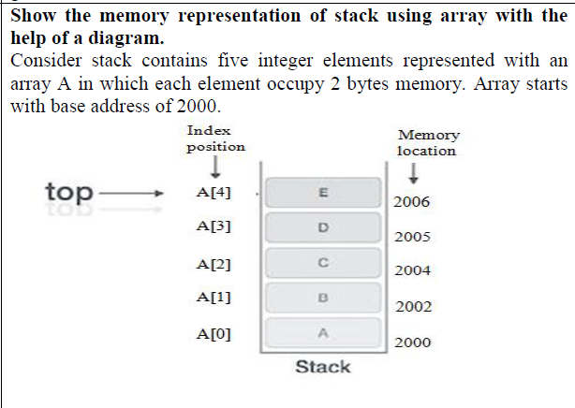

Slide 17
What is the affect of PUSH and POP operations onto the stack. The stack contain 10,20,22,26,28,30 with 30 being at top of the stack. Show diagrammatically the effect of :-
PUSH 46
PUSH 48
POP
POP
POP
PUSH 82

Slide 18
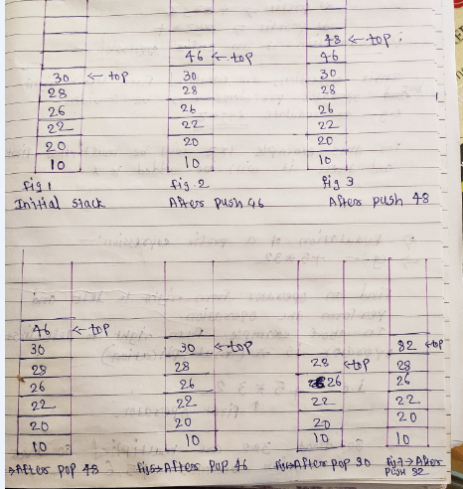

Slide 19
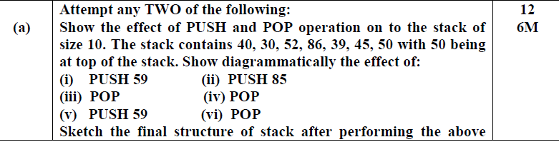

Slide 20
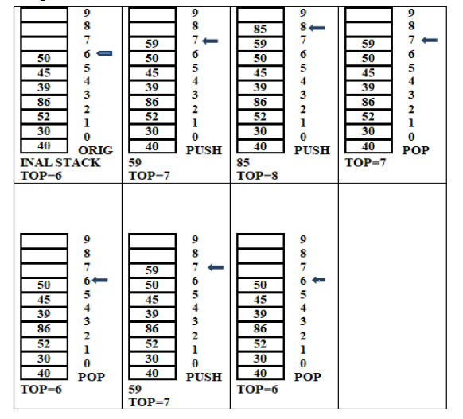

Slide 21
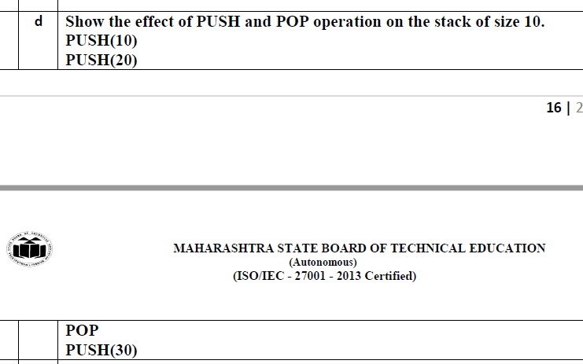

Slide 22
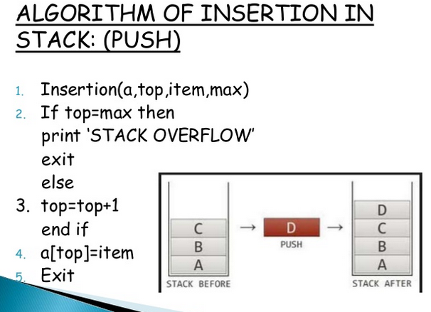
PUSH operation

Slide 23
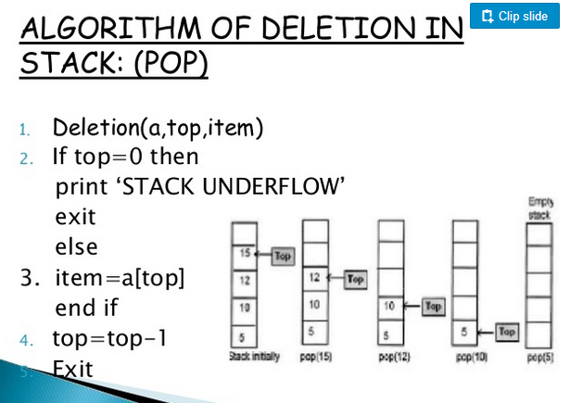

Slide 24
Expression Representation
Three methods for Expression representation
1.Infix 2.Prefix 3.Postfix
1.Infix :- where operator is in between operands
ex:- a + b

Slide 25
Expression Representation
2) Prefix :- where operator is before operands
Example:- + a b

Slide 26
Expression Representation
3) Postfix:- where operator come after operand
Example:- a b +

Slide 27
Another example
1. Infix:- a + b * c
2.Prefix:- + a * b c
3. Postfix:- a b c * +

Slide 28
Evaluation of Infix expression
Infix expressions are evaluated from left to right but operator precedence(priority) must be consider.
Example:- a + b * c
In above example b * c will be multiplied first and then it will be added to a.
5 + 6 * 2
=5 + 12
=17

Slide 29
Evaluation of Prefix expression
Find an operator from right to left and perform the operation.
Example:- + 5 * 3 2
Here from right to left first operator is multiplication ,so that 2 and 3 will be multiplied
So expression becomes + 5 6
Again from right to left first operator is +
So that 6 + 5
Expression becomes 11.

Slide 30
Evaluation of Postfix expression
Find an operator from left to right and perform the operation.
Example:- 5 3 2 * +
Here from left to right first operator is multiplication ,so multiply 3 * 2
So expression becomes:- 5 6 +
Again from left to right first operator is addition ,so add 5 + 6
Expression becomes :- 11

Slide 31
Evaluation of Postfix expression using a Stack
Given expression is :- 6 5 3 + 9 * +

Slide 32
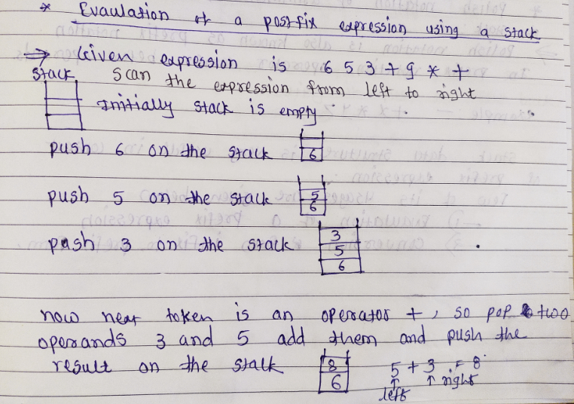

Slide 33
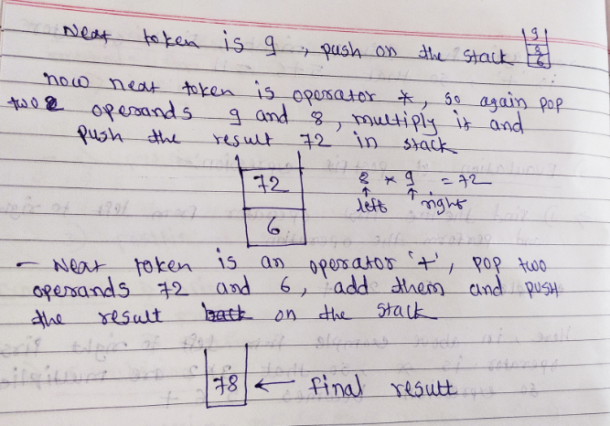

Slide 34
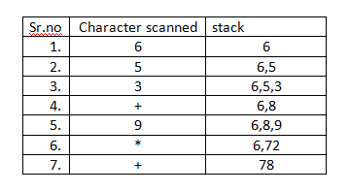
Evaluation of postfix expression 6 5 3 + 9 * +
In postfix expression ,scan the expression from left to right

Slide 35
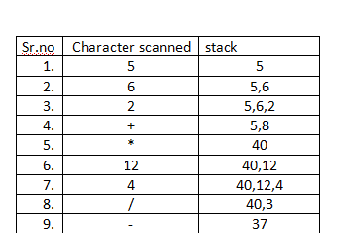
Evaluate the postfix expression 5 , 6 , 2, +, *,12,4,/ ,-
In postfix expression ,scan the expression from left to right

Slide 36
Evaluation of Prefix expression
Find an operator from right to left and perform the operation.
Example:- + 5 * 3 2
Here from right to left first operator is multiplication ,so that 2 and 3 will be multiplied
So expression becomes + 5 6
Again from right to left first operator is +
So that 6 + 5
Expression becomes 11.

Slide 37
Evaluation of Prefix expression using a Stack
Evaluate the prefix expression + , - ,2,7, * 8 , /,4,12

Slide 38
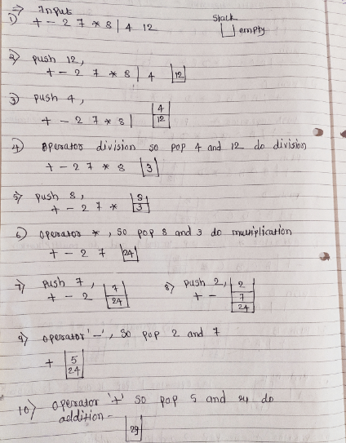

Slide 39
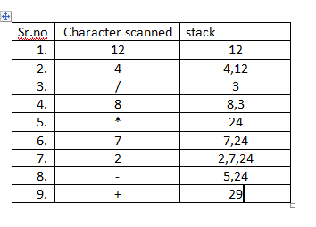
Evaluate the prefix expression + , - ,2,7, * 8 , /,4,12
In prefix expression ,scan the expression from right to left

Slide 40
Solve it by prefix method
- , + , *, 2, 3,*,5,4,9
Ans:- 17

Slide 41
Introduction to Recursion
Recursion is a process of expressing a function in terms of itself.
The function which is called itself in its own body of the program is called Recursive Function.

Slide 42
WAP for Factorial of a number using Recursive
int fact(int);
void main()
{
int x,n;
clrscr();
printf(“\n Enter the value for n:”);
scanf(“%d”,&n);
x=fact(n);
printf(“\n factorial is :%d”,x);
getch();
}

Slide 43
int fact(int n)
{
if(n==0)
return(1);
return(n*fact(n-1));
}
o/p:- Enter the value of n: 5
factorial is :120

Slide 44
Advantages of Recursion
1.The recursion is very flexible in data structure like stacks, queues, linked list and quick sort.
2.Using recursion the length of the program can be reduced.

Slide 45
Precedence(Priority) of Operators
( ) highest
^ :- first priority
* , / :- Second priority
+ , - :- third priority

Slide 46
Conversion of Infix expression into prefix/postfix expression
Conversion of expression will be done by considering the priorities of operators.
Conversion of an expression can be done in two methods:
Manual method
Stack method

Slide 47
Manual method
1.Completely parenthesize the expression to understand the order of operations.
2.To convert infix to prefix ,move the operators to the left side of the brackets.
3.To convert infix to postfix move the operators to the right side of the brackets.

Slide 48
Convert infix to prefix manual method
1.Paranthesize the infix expression according to the priority
2.Move each operator to its corresponding left parenthesis .
3.Remove the parenthesis

Slide 49
Infix to prefix example
Ex1:- a+b*c original expression
1. Parenthesize the infix expression according to priority so a + (b *c)
(a + (b * c) ) infix expression
2.Move each operator to left (a+*bc)
+a*bc converted prefix expression

Slide 50
Infix to prefix
Ex2:- a+b*c-d original expression
a+(b*c)-d
(a+(b*c)-d) infix expression after giving the paraenthesis
(a+*bc-d)
+a*bc-d
-+a*bcd

Slide 51
INFIX TO PREFIX
Ex3: (A + B ^ C ) * D + E ^ 5
(A + (B ^ C) )* D + (E ^ 5)
first calculate B ^ C i.e ^ BC
So, (A + ^ B C) *D + E ^ 5)
+ A ^ B C * D + E ^ 5
* + A ^ B C D + E ^ 5
* + A ^ B C D + ^ E 5
+ * + A ^ B C D ^ E 5

Slide 52
Convert infix to postfix manual method
1.Paranthesize the infix expression according to the priority
2.Move each operator to its corresponding right parenthesis .
3.Remove the parenthesis

Slide 53
Infix to postfix
Ex1:- a + b*c original expression
1.Parenthesize the infix expression according to priority so a+(b*c)
(a+(b*c)) origional expression
2.Move each operator to right (a+bc*)
abc*+ final postfix expression

Slide 54
Infix to postfix
Ex2:- a + b ^ c *d + e ^ 5 original expression
( (a + (b ^ c) *d + (e ^ 5) )
((a+b^c)*d + e ^ 5)
Now b ^ c must be calculated first
(a + bc^)*d + e ^ 5
abc^+ *d+e^5
abc^+d*+e^5
abc^+d*+e5^
abc^+de5^*+ final postfix expression

Slide 55
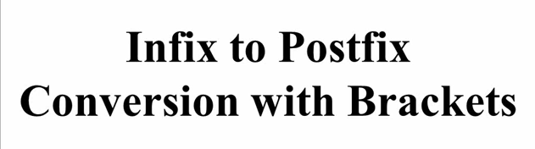
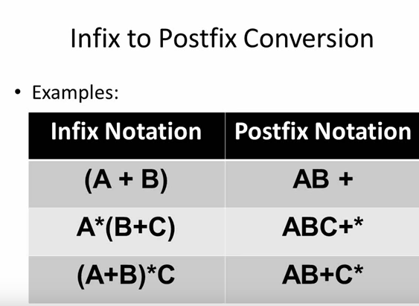

Slide 56
Algorithm to convert infix expression to postfix expression using stack
The postfix expression will be constructed left to right using operands from original expression and operators are removed from stack.
The algorithm is finished when stack is empty.

Slide 57
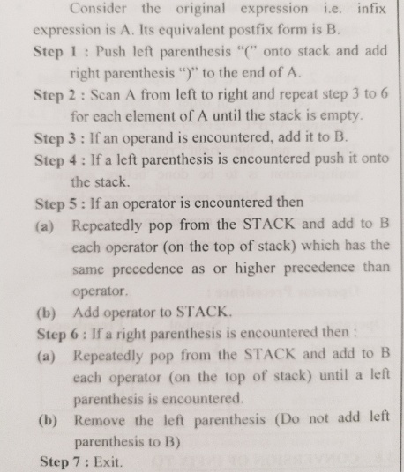

Slide 58
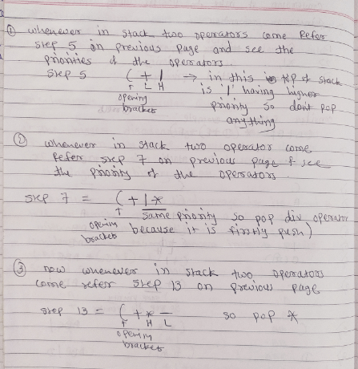

Slide 59
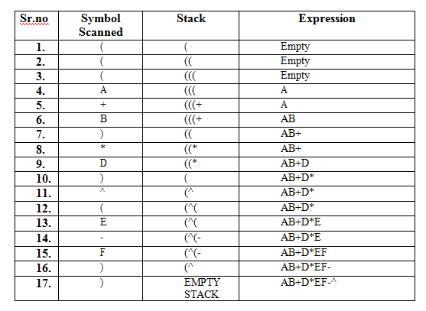
CONVERT INFIX TO POSTFIX ((A+B)*D)^(E-F)
After giving parenthesis to infix expression: (((A+B)*D)^(E-F))

Slide 60
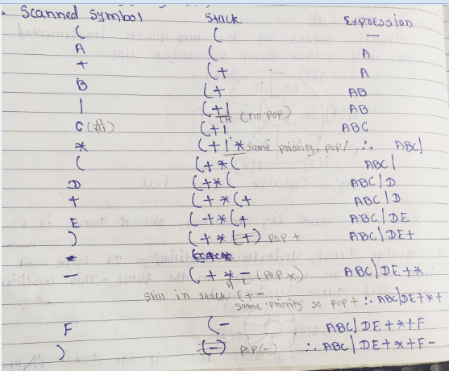
Convert Infix to postfix (A+B/C*(D+E)-F) = ((a+b/c*(d+e)-f))

Slide 61
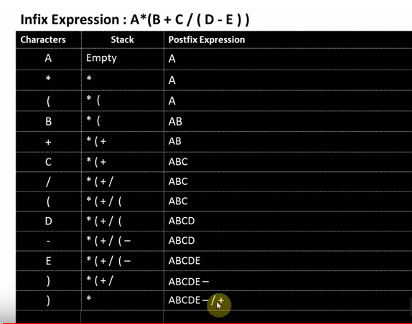

Slide 62
Algorithm to Convert infix to prefix expression
Push ‘)’ onto stack and add ‘(‘ to the end of A
Scan A from right to left and repeat steps 3 to 6 for each element of A until the stack is empty.
if an operand is encountered add it to B.
If a right parenthesis is encountered push it onto stack.
If an operator is encountered then
a) Repeatedly pop from stack and add to B each operator which has same or higher precedence than the operator

Slide 63
b) Add operator to stack
6. If a left parenthesis is encountered then
Repeatedly pop from the stack and add to B
Remove the left parenthesis
7) exit

Slide 64
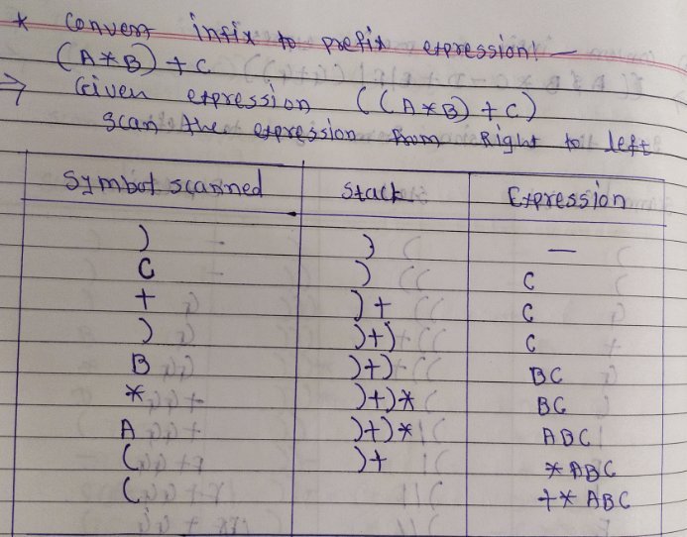

Slide 65
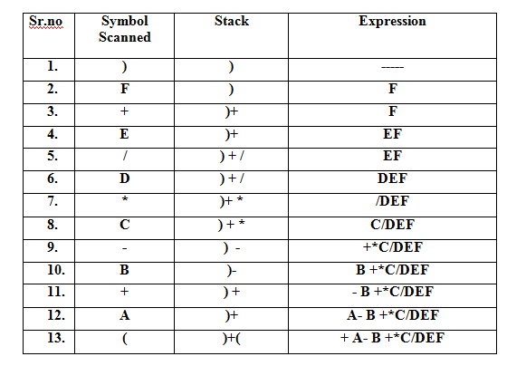
Convert infix to prefix A + B – C * D/E + F Add the parenthesis and scan the expression from right to left After adding Parenthesis (A+B –C *D/E+F)

Slide 66
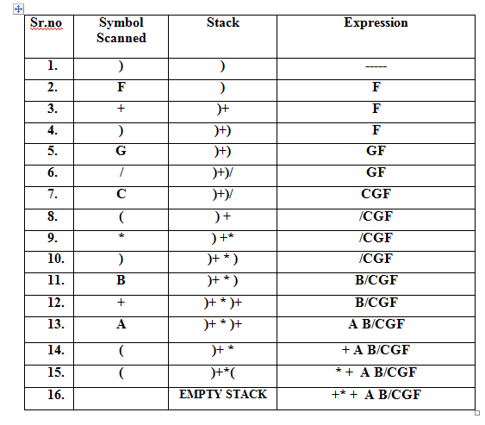
Convert infix to prefix (A+B)*(C/G)+F
Add the parenthesis and scan the expression from right to left
AFTER ADDING PARENTHESIS ((A+B)*(C/G) +F)

Slide 67
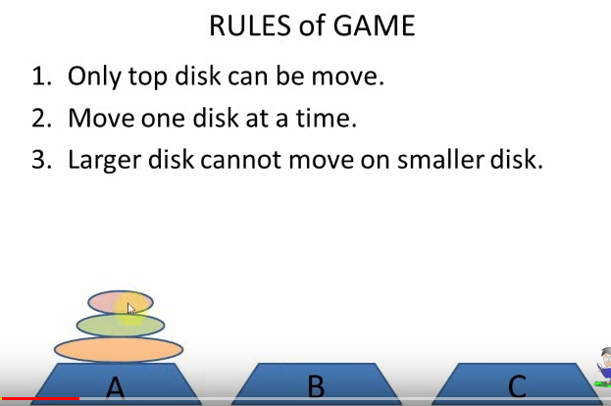
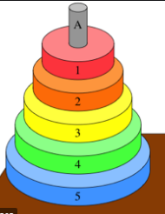
Tower of Hanoi

Slide 68
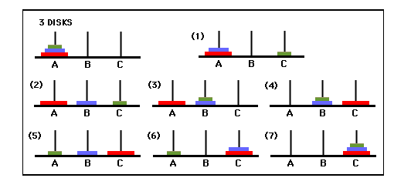
TOWER OF HANOI

Slide 69
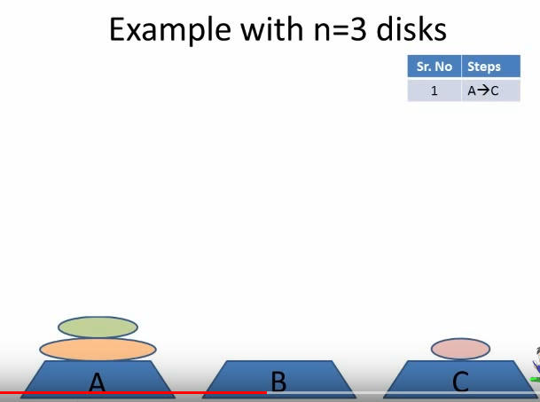

Slide 70
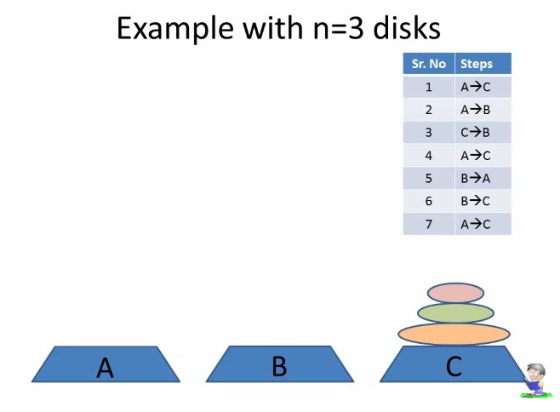

Slide 71
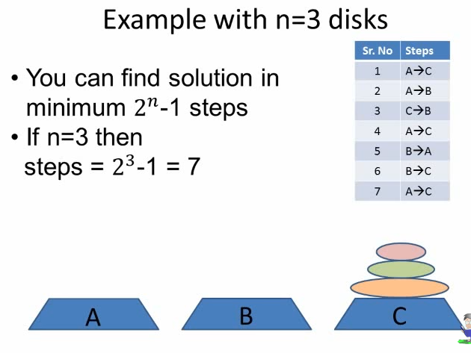

Slide 72
Queue
It is an ordered group of items of elements.
Queues have two ends:
Elements are added at one end.
Elements are removed from the other end.
The element added first is also removed first
(FIFO: First In, First Out).

Slide 73
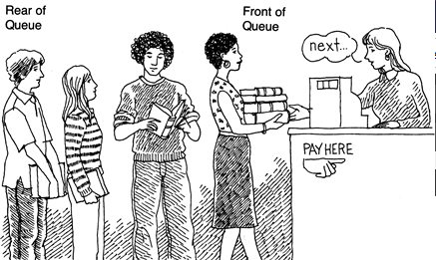

Slide 74
Types of Queue
1. Linear Queue
2.Circular Queue
3.Double ended queue
4. Priority Queue

Slide 75
Stack | Queue
Stack is a LIFO data structure | Queue is a FIFO data structure
In a stack ,all insertion and deletions are permitted only at one end of stack which is called as Top of stack | In a queue items are inserted at one end called the Rear and deleted from the other end called the Front
Stack is widely used in recursion | Queue is more useful in many of the real life applications
Example:- A stack of plates, A stack of coins | Example:-A queue of people waiting to purchase tickets.

Slide 76
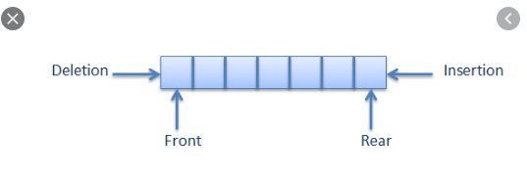
Deletion and insertion in Queue

Slide 77
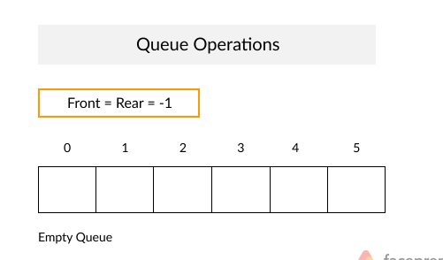

Slide 78
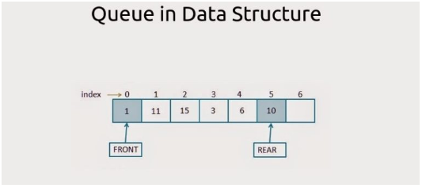
1,11,15,3,6,10

Slide 79
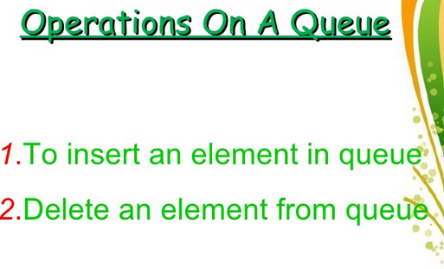

Slide 80
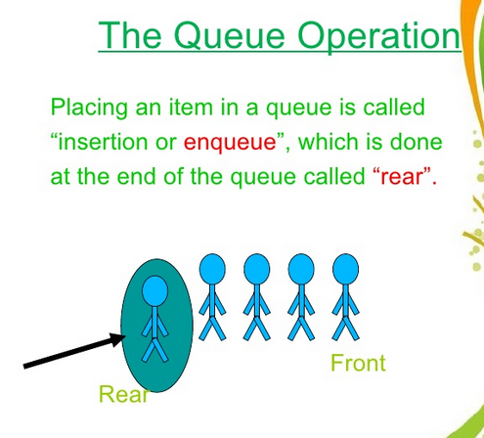

Slide 81
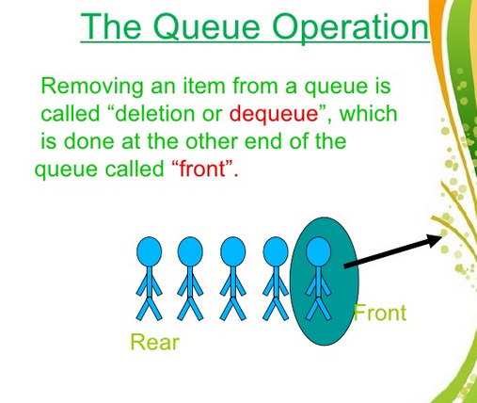

Slide 82
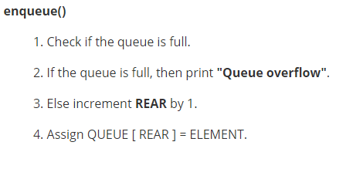

Slide 83
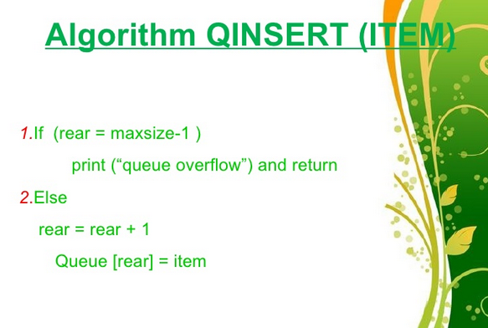

Slide 84
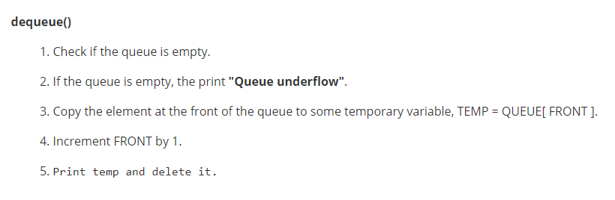

Slide 85
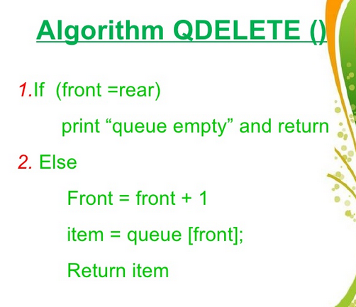

Slide 86
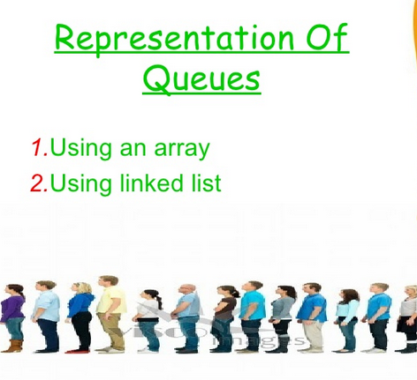

Slide 87
Disadvantage of Linear Queue
The disadvantage of using the Linear queue is as
we delete the elements, the front moves ahead, even though the queue is empty we still cannot add the elements in the queue.

Slide 88
Uses of Queue
In computer system to maintain waiting list for single shared resources such as printer, disk, etc.
It is used as buffers on MP3 players, iPod playlist, etc.
Used for CPU scheduling in multiprogramming and time sharing systems.

Slide 89
In real life, Call Center phone systems will use Queues, to hold people calling them in an order, until a service representative is free.
Handling of interrupts in real-time systems.

Slide 90
Circular Queue
Circular Queue can be viewed as a Wire ,in which the two ends of the wire are connected together.
Circular Queue is a linear data structure in which the operations are performed based on FIFO (First In First Out) principle .
In Circular Queue the last position is connected back to the first position to make a circle.

Slide 91
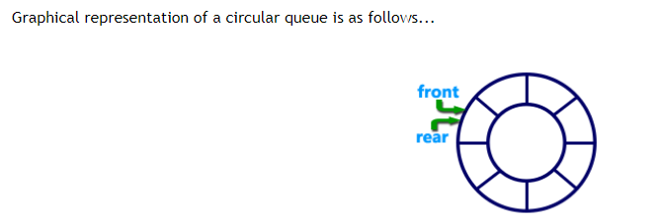

Slide 92
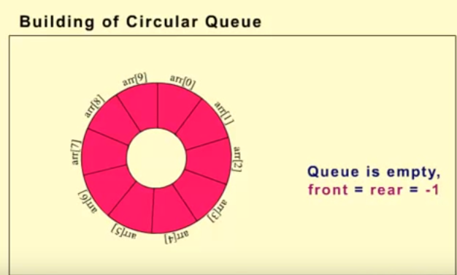

Slide 93
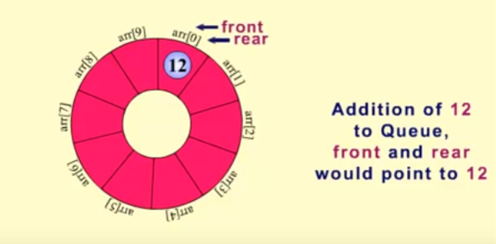

Slide 94
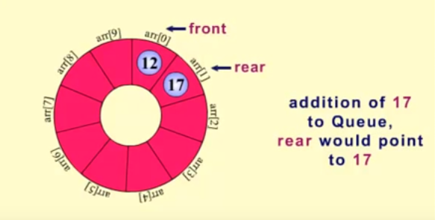

Slide 95


Slide 96


Slide 97


Slide 98


Slide 99


Slide 100


Slide 101


Slide 102


Slide 103


Slide 104


Slide 105


Slide 106
Assumptions for Circular Queue
Front will always be pointing to the first element (as in linear queue)
If Front= Rear =-1 or (front=-1 && Rear=-1 )
Then queue will be empty

Slide 107
Assumptions for Circular Queue
3.Each time a new element is inserted into the queue so the Rear is incremented by one.
i.e. Rear=Rear + 1;
4. Each time an element is deleted from the queue so the Front is incremented by one.
i.e. Front=Front + 1;

Slide 108
Circular Queue Full(Overflow)
If Front = 0 and Rear = Maxsize – 1 then the circular queue is full.

Slide 109
Circular Queue Empty(Underflow)
If front=-1 and rear =-1
Then there are no elements in the queue.
This condition is called queue “Underflow” or “Empty Queue”

Slide 110
Priority Queue
A priority queue is an abstract data type in which each element is assigned a priority.
An element with higher priority is processed before an element with a lower priority.
Two elements with the same priority are processed on a first Come-first Served basis.

Slide 111
Advantage of Priority Queue
It is useful data structure for prioritizing jobs in operating system.
It is useful for categorizing data.
It is mostly used in Simulations.

Slide 112
Applications of Queue
1.Simulation:- means to help the user for obtaining the output of the program.
It permits the user to make several trials for getting the actual results and planned situations without disturbing the real situation.

Slide 113
Applications of Queue
2.CPU scheduling in multiprogramming and time sharing environment:-
In multiprogramming several processes are kept in memory at one time.
When one process is waiting for input output ,the Operating system takes the CPU away from that process and gives the CPU to another process.

Slide 114
3.Round robin scheduling:-
It is used for time sharing system.
The circular queue is used to implement such algorithms.

